Slide 1


Agenda
Spring Light Weight Container
Inversion Of Control Design Principle
Spring Modules
Aspect Oriented Programming (AOP)
New Features in Spring 3.0
Demo
Q & A

Slide 2

What is a Container ?
A framework in which application code runs
Delivers enterprise services
  Messaging
  Remoting
Application objects, business objects, are managed by the container
  Web container, manages servlets objects
  Application Server, manages EJB’s
  Lightweight container, manages POJO’s(Plain Old Java Object)

Slide 3
The Light Weight Container
Non – invasive
  application code does not depend on the container.
Quick to start
Consistent model in any environment
No Special Deployment steps
Pure Java , not J2EE only manages POJO’s.

Slide 4
What is Spring Framework ?
The spring framework is an open source application framework that aims to make the J2EE development easier
Enable applications to be coded from POJOs
Allow for enterprise services to be applied to those POJOs in a declarative, non – invasive way
Decouples the application object from their environment

Slide 5
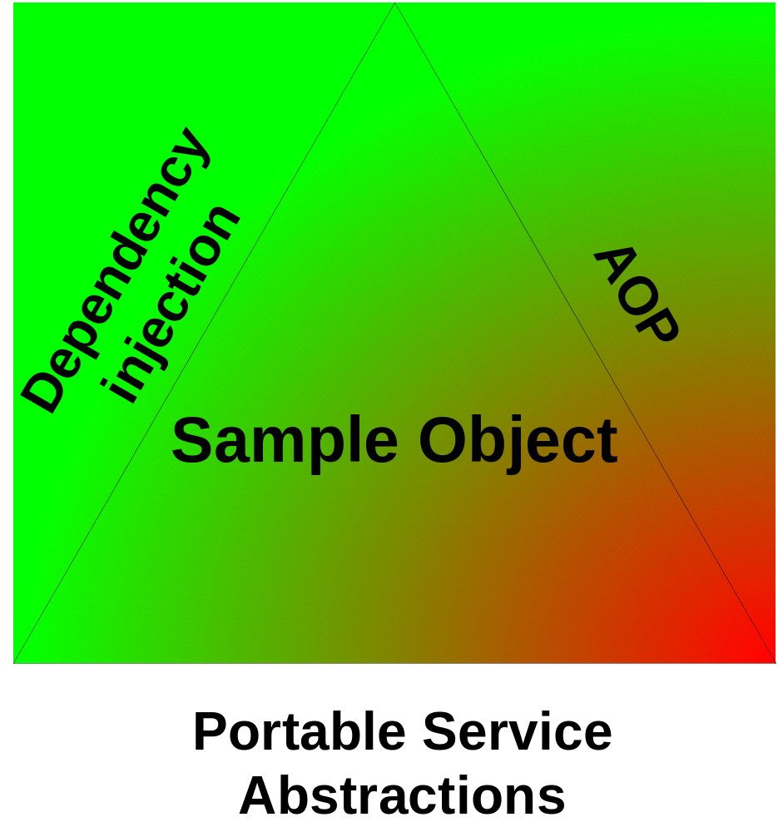
The Spring Triangle

Slide 6
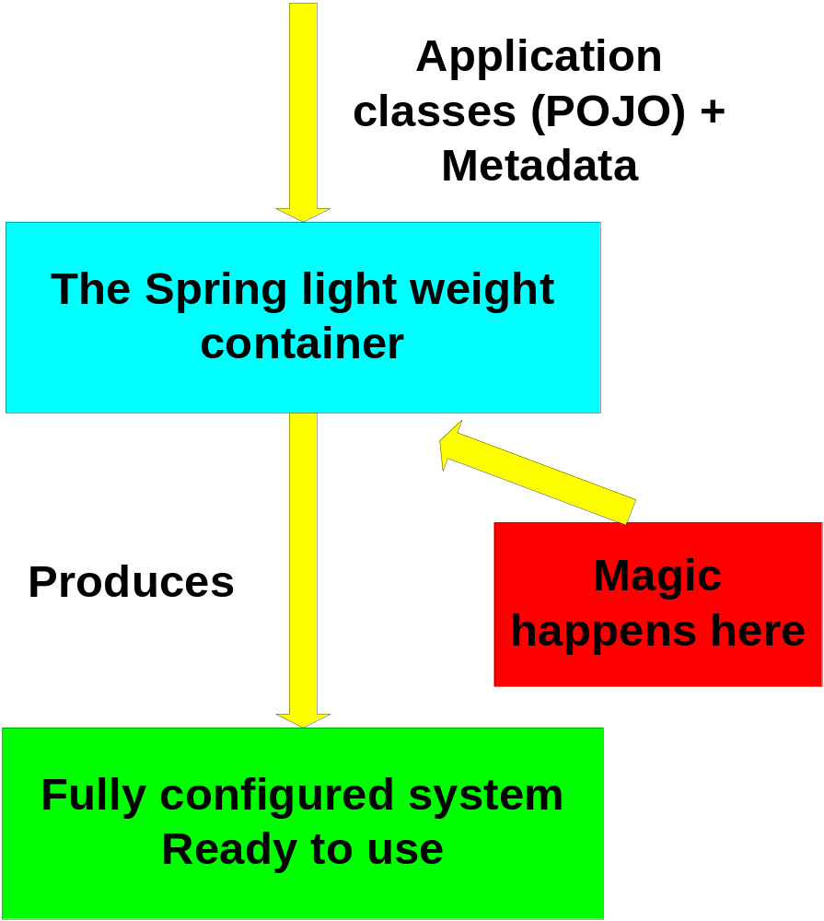
The Spring Container in Action

Slide 7
Spring Framework Architecture Enables
Lets us view our application as a set of components
Each component is a POJO focused on solving the domain problem
The Spring Container manages the “glue code” required for component configuration and assembly
Each component is testable in isolation

Slide 8
Inversion of Control
Described as Hollywood principle
  “Don’t call us, we will call you “
Moves control from application code into framework
Common technique in frameworks, as opposed to class libraries
  Application code calls a class library
  An inversion of control framework calls application code
  Control is “inverted”

Slide 9
Inversion of Control Cont …
Dependency Injection
  Beans define their dependencies through constructor arguments or properties(setter and getter methods)
  The container provides the injection at runtime
Decouples object creators and locators from application logic
Easy to maintain and reuse
Testing is easier

Slide 10
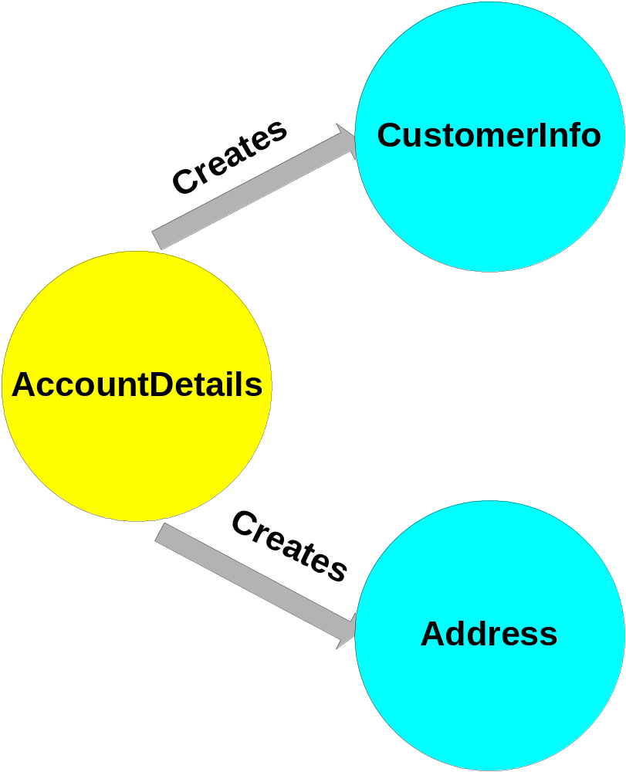
Non - Inversion Of Control

Slide 11
Non - Inversion Of Control Code
package com;
public class AccountDetails {
private CustomerInfo cI= null;
private Address add = null;
public AccountDetails(){
cI = new CustomerInfo();
add = new Address();
}
// getters and setters
}

Slide 12
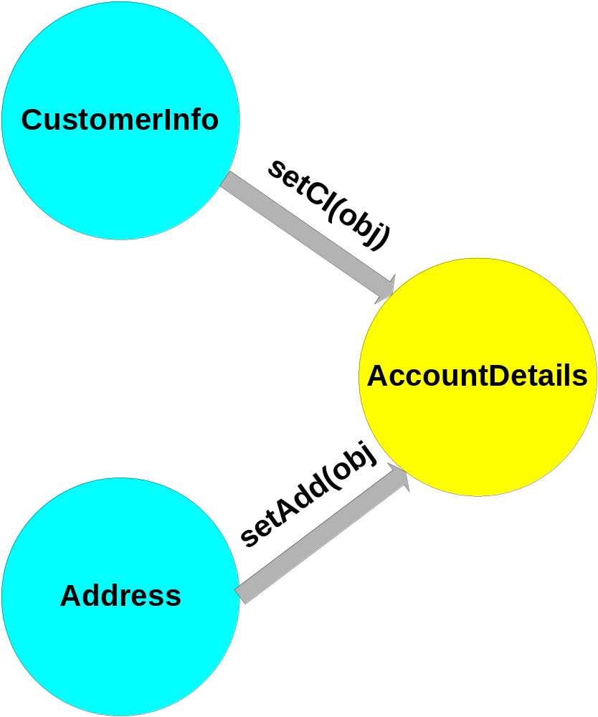
Inversion Of Control

Slide 13
Inversion Of Control code
package com;
public class AccountDetails {
private CustomerInfo cI= null;
private Address add = null;
public AccountDetails(){
}
// getters and setters

Slide 14
Sample Spring Configuration File (*.xml)
<beans xmlns="http://www.springframework.org/schema/beans"
xmlns:xsi="http://www.w3.org/2001/XMLSchema-instance"
xsi:schemaLocation="
http://www.springframework.org/schema/beans http://www.springframework.org/schema/beans/spring-beans-3.1.xsd">
<bean id="customerinfo" class="com.CustomerInfo"></bean>
<bean id="address" class="com.Address"></bean>
<bean id="accountdetails" class="com.AccountDetails">
<property name=“cI">
<ref bean="customerinfo" />
</property>
<property name="add">
<ref bean="address" />
</property>
</bean></beans>

Slide 15
Why is Dependency Injection so important?
Pluggability
  Replace the implementation of any class without affecting callers
Hot swapping
  Container can add a level of indirection to allow an object to change without affecting callers
Promotes natural OO design

Slide 16
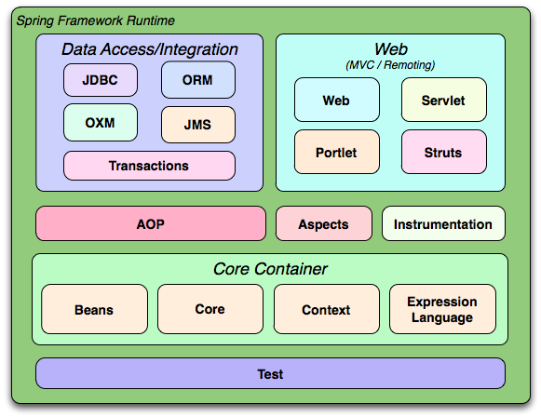

Spring Modules

Slide 17
Spring 3 new Features
Java 5 support
Spring Expression Language
Object to XML mapping functionality (OXM)
IoC enhancements/Java based bean metadata
Type conversion system and field formatting system

Slide 18
Aspect Oriented Programming (AOP)
AOP decomposes a system into concerns, instead of objects
  Concern : something that we are “concern” about
Deals with "aspects" that cross-cut across the code and can be difficult to modularize with OOP.
Common Example : Logging
  Logging code typically scattered all over a system
  With AOP, we can declare, for example, that a system should write a debug log at the beginning and end of all method invocations

Slide 19
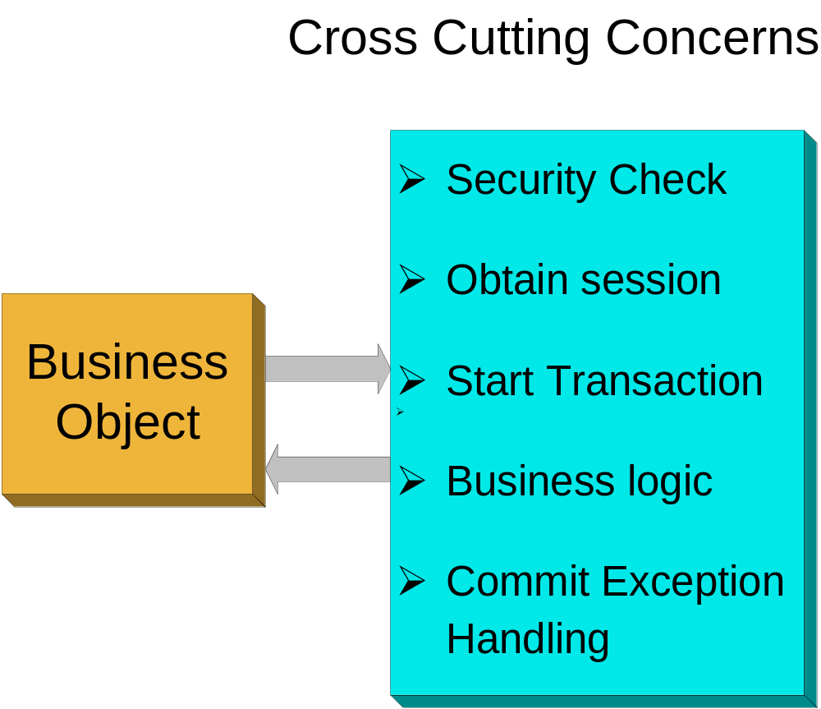
Aspect Oriented Programming Cont …

Slide 20
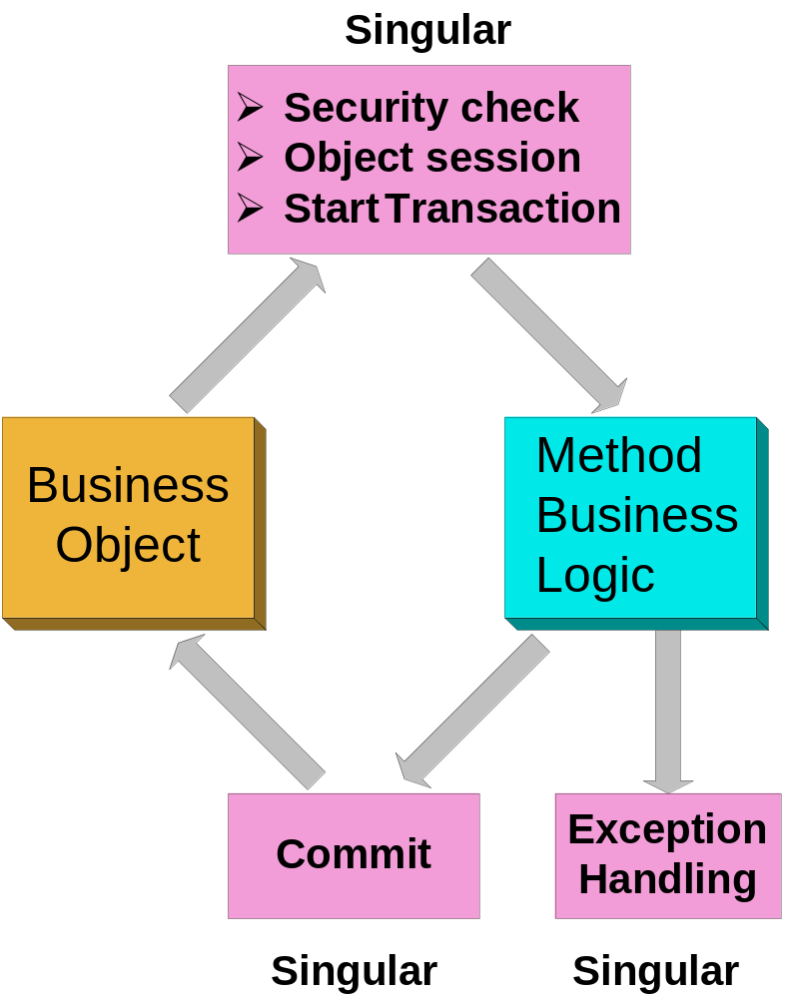
Aspect Oriented Programming Cont …

Slide 21



Pros and Cons of Spring Framework
Pros
  Metadata controlled dependency resolve
  Spring provides a consistent way to wire components together
  Spring provides integration points with standard interfaces:Hibernate, JDO, TopLink,EJB, RMI, JNDI, JMS, Web Services, Struts
    Huge productivity gains possible through not having to write the common integration points
Cons
  Learning curve

Slide 22
Summary
Light Weight Container
IOC
Pros & Cons
Spring
AOP
Spring Triangle
Integration

